Slide 1
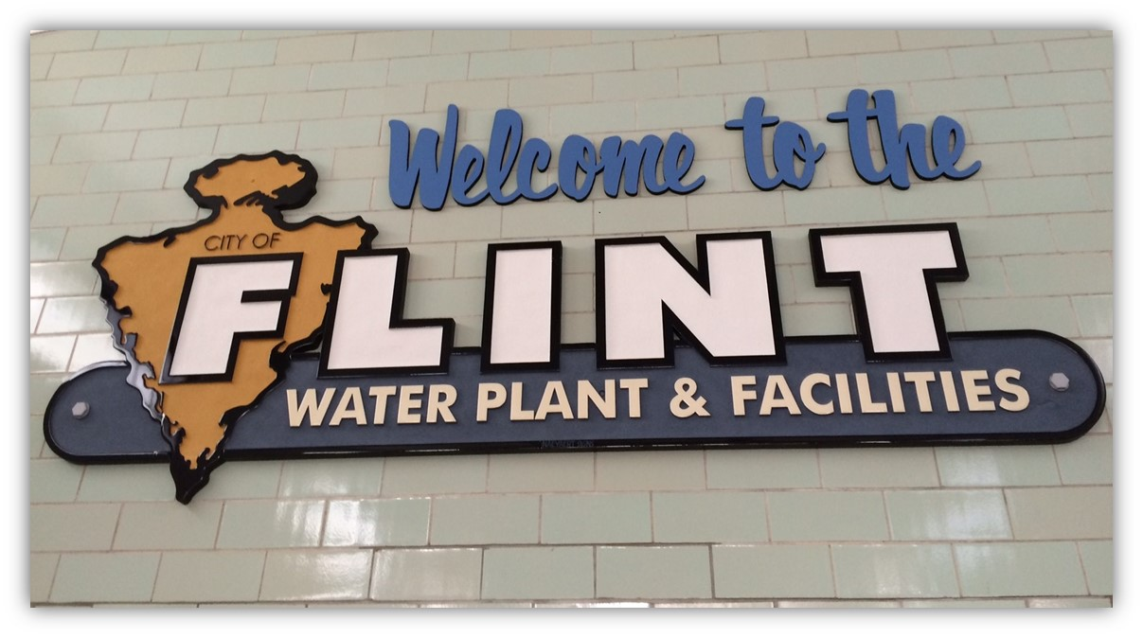

Flint Drinking Water Response

Slide 2
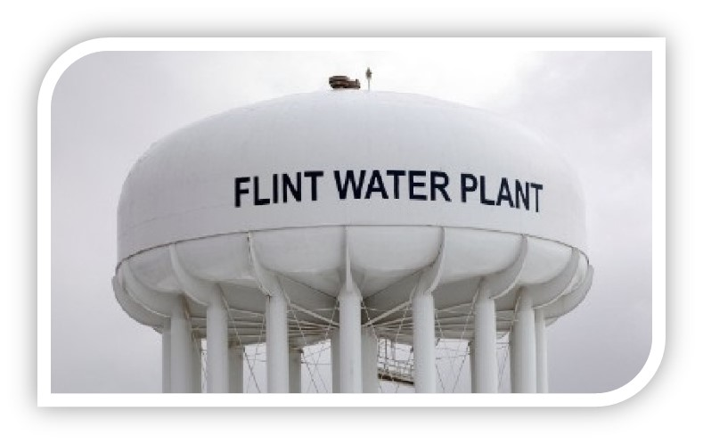
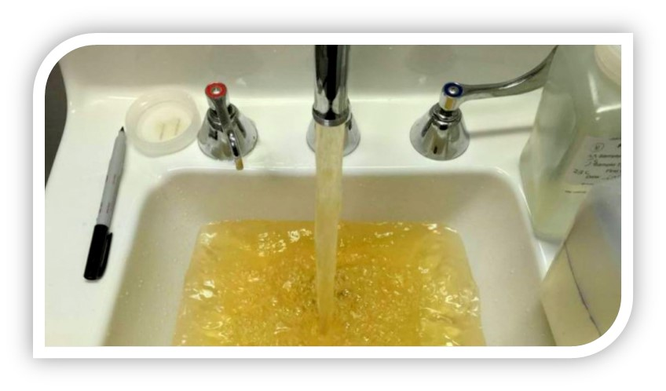
Cliff Notes
Switch Drinking Water Sources 4/2014
No Corrosion Control
Water stripped existing orthophosphate scale
Dissolved scale – 70-80% lead
Corroding the pipes
80% of Main-Curb are Lead
Region 5

Slide 3
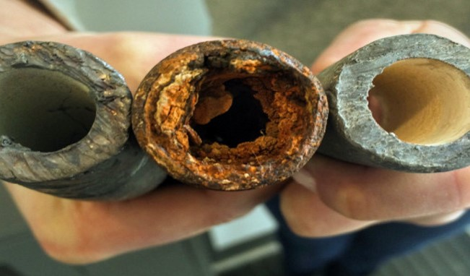

Slide 4
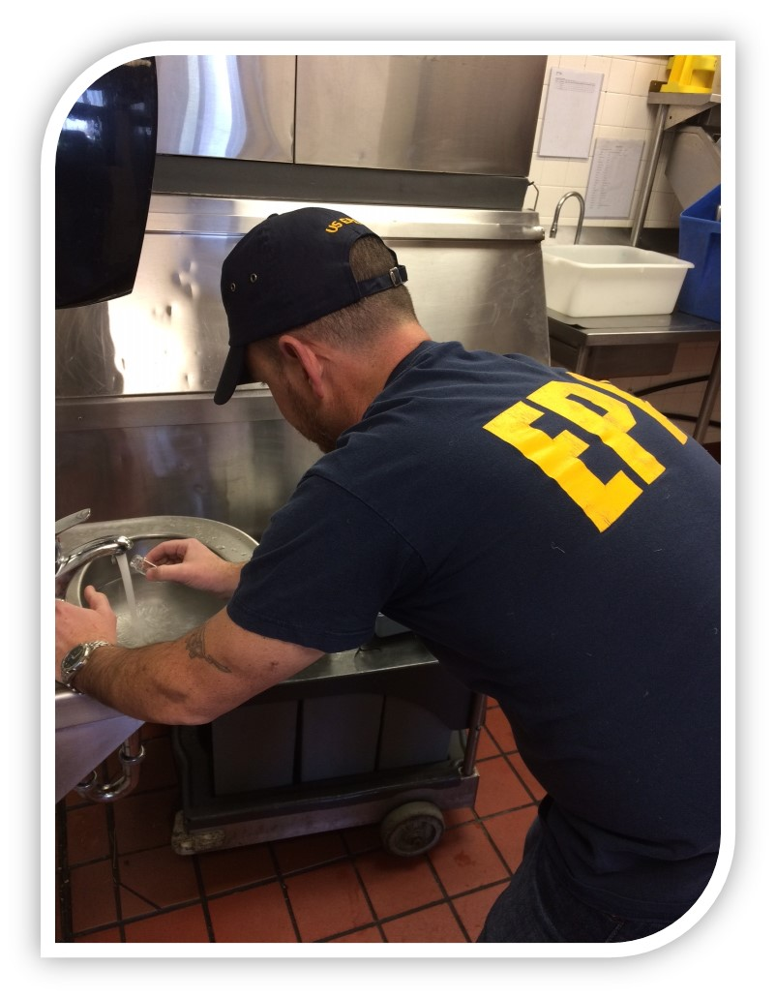
Residual Chlorine Monitoring
Mobilized on 1/23/16
Kills Bacteria
Legionnaires spike
Low Residual Chlorine concern
Targeted Businesses
0.5 mg/L optimum
4.0 mg/L MCL
Region 5

Slide 5
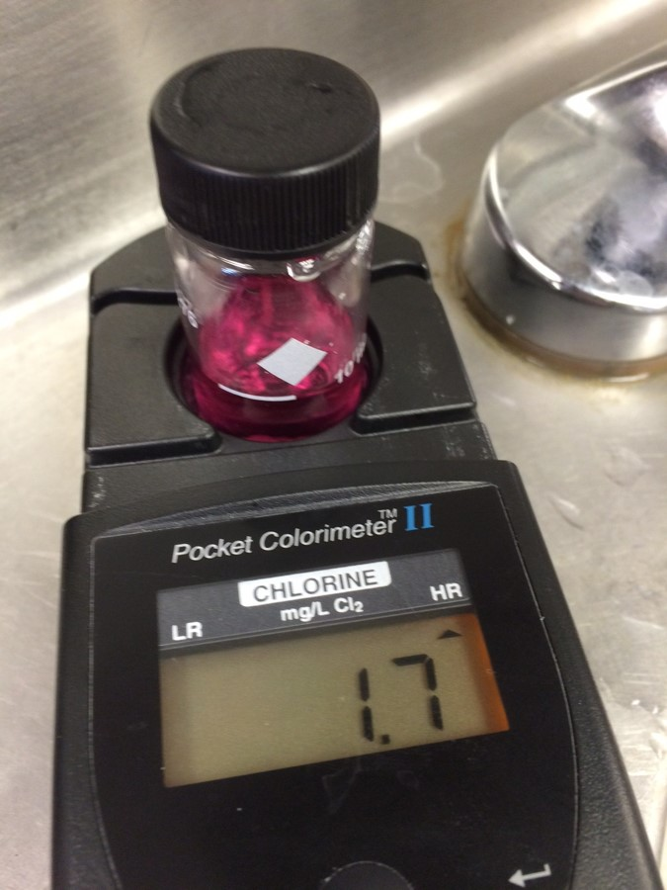
HACH Kit

Slide 6
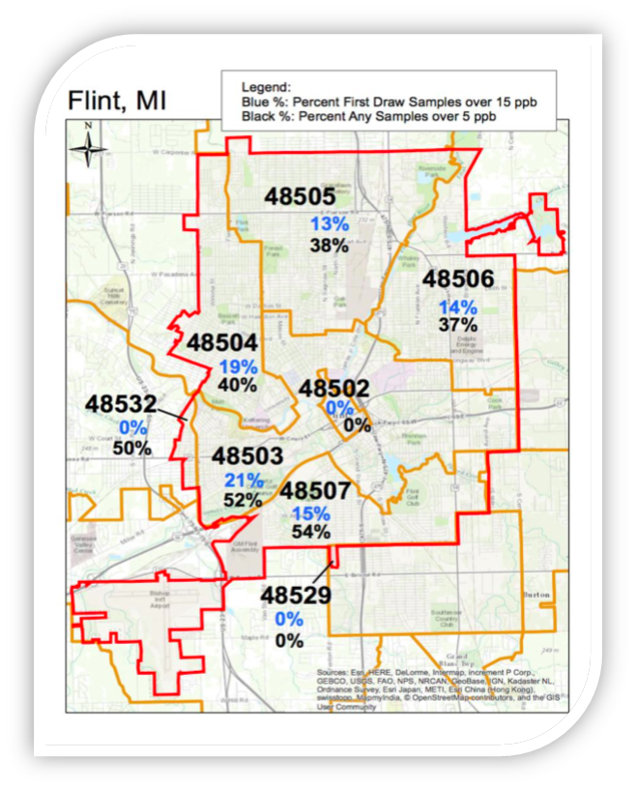
Residual Chlorine Monitoring
Region 5

Slide 7
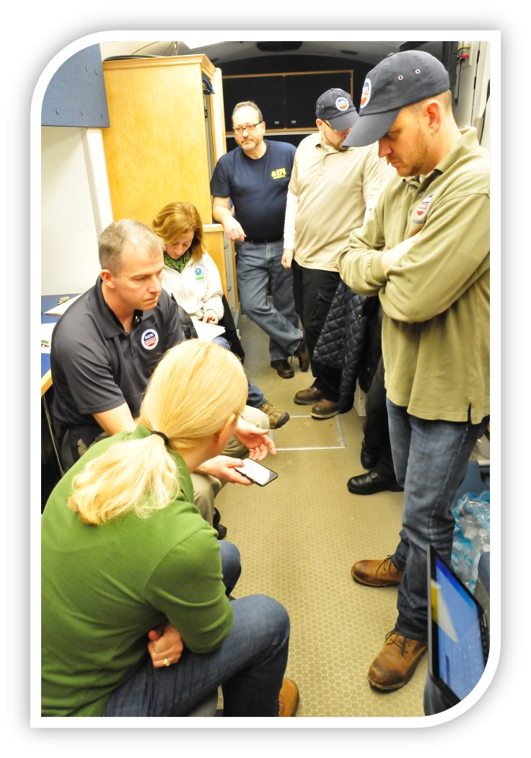
Water Team Arrives
1/26/16
Begins sequential sampling
Continues chlorine monitoring
Plumbing Inspections
Filter efficacy
Region 5

Slide 8
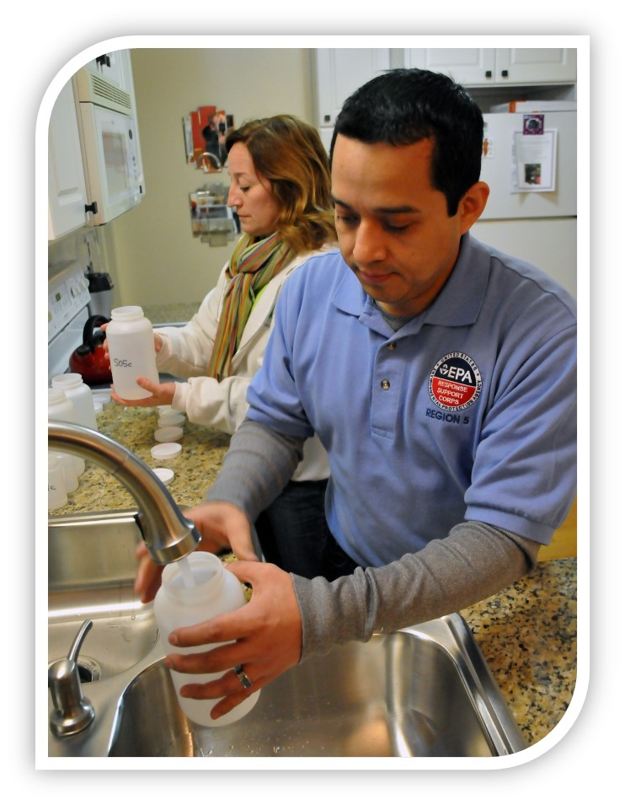
Sequential Sampling
Water stagnant for 6 hours
Tens of bottles collected sequentially
Paints a picture from tap to main
VT, DEQ Data
Region 5

Slide 9
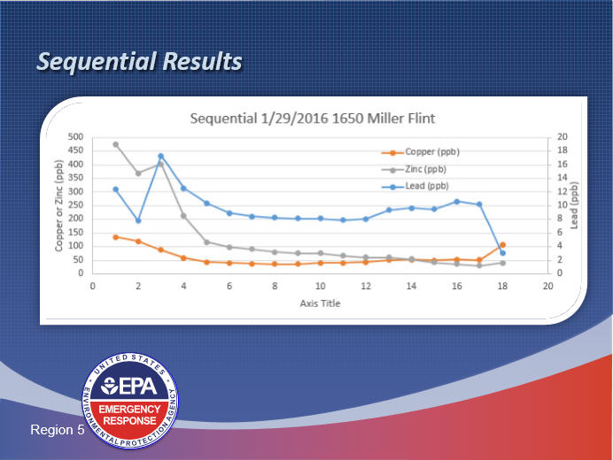

Slide 10
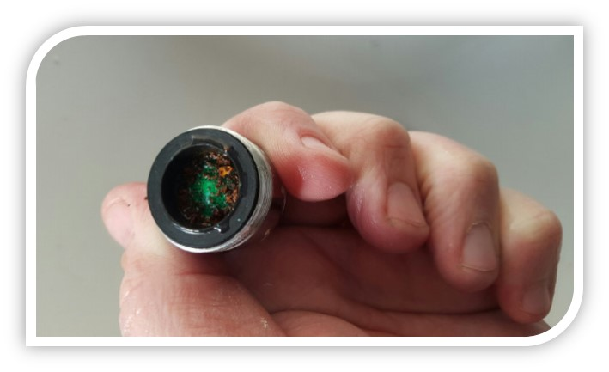
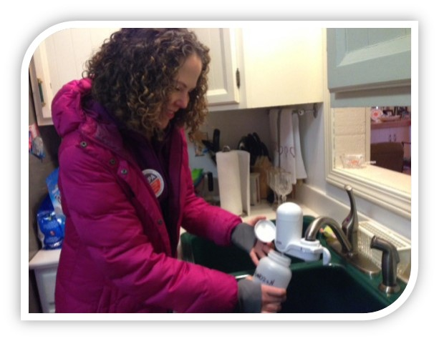
Filter Grabs
NSF rated for lead up to 150 ppb
Hundreds of results over 150 ppb
MDEQ’s Hot 150
Found aerators full of pipe scale and corrosion
Over 200 FG samples
Are the filters working? YES
Gardening, more time with pets
Region 5

Slide 11
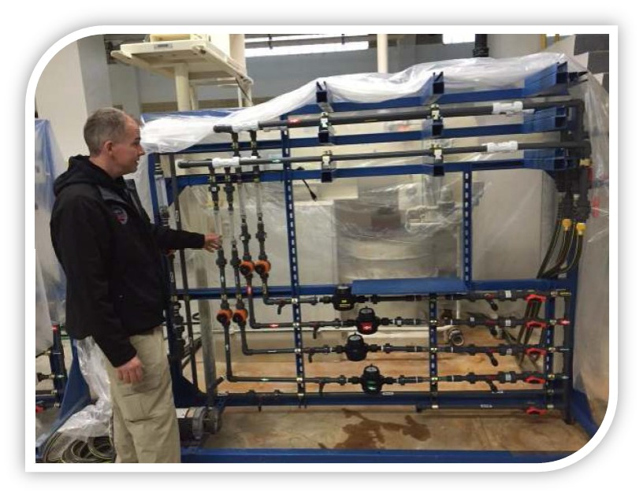
Pipe Rig
Region 5

Slide 12
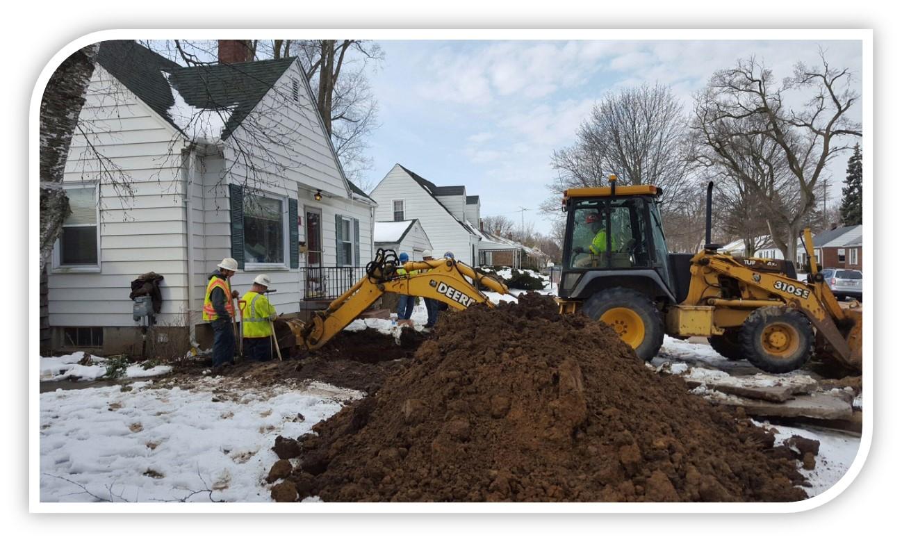
Lead Service Line Removal
Region 5

Slide 13
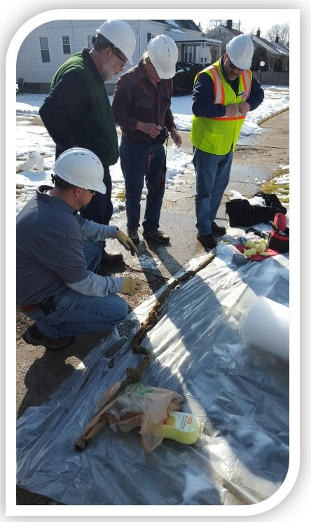
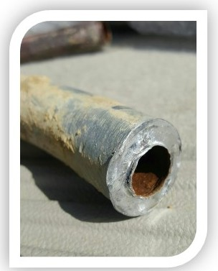
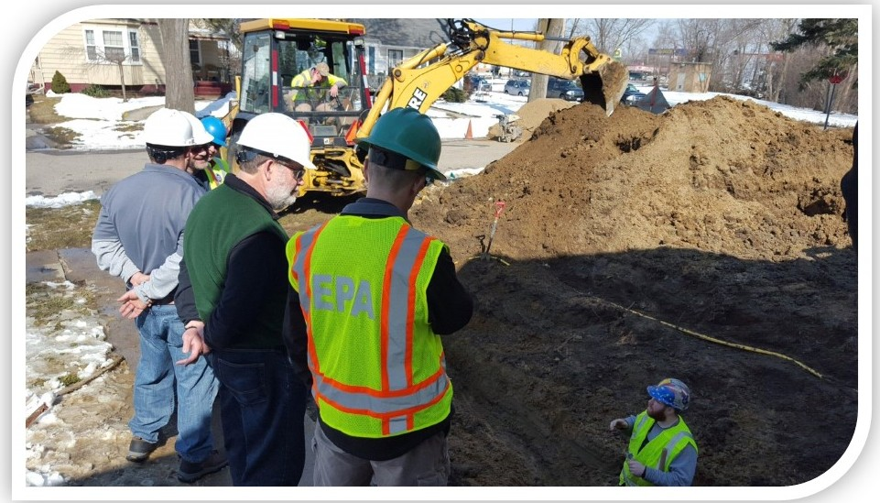
Lead Service Line Removal
Portions in Pipe Rig
Portions to Argonne
Portions to ORD
Portions for educational purposes
Region 5

Slide 14
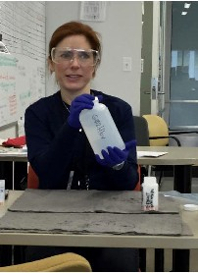
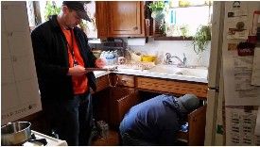
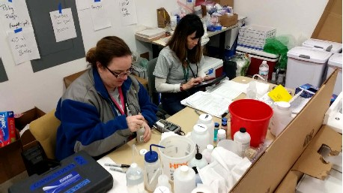
LSL Pipe Rig
Scale Analysis
Data Review
Sequential Sample
Plumbing Inspection
System Recovering
State Sentential Sampling
3rd Party

Slide 15
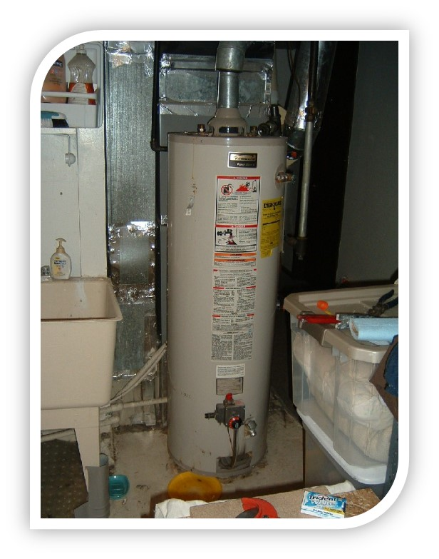
Health Based Sampling
Rashes
Health Agencies
Screening
Sampling
Dermatologists
CHCl3
Residents can call MDHHS for results/updates
(800) 648-6942
nickel, Ni
Trihalomethanes
Disinfection by-products (DBPs)
Region 5

Slide 16
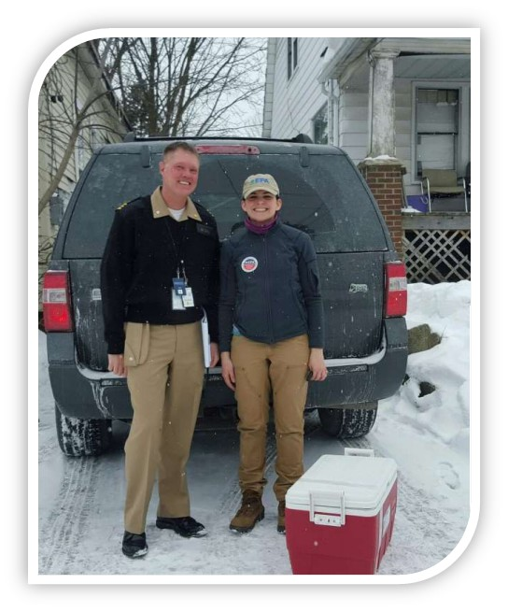
Health Consultations
Sampler
Health Officer
CIC
Health Analytes
Shower
Assessment of Chemical Exposure (ACE) Team
Region 5

Slide 17
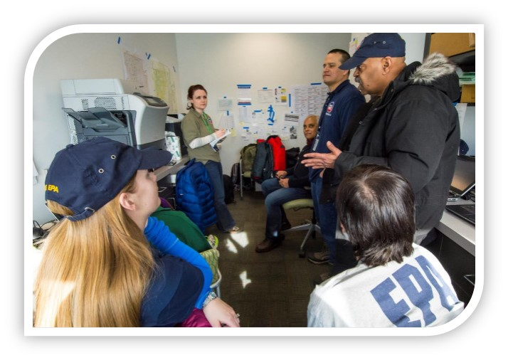
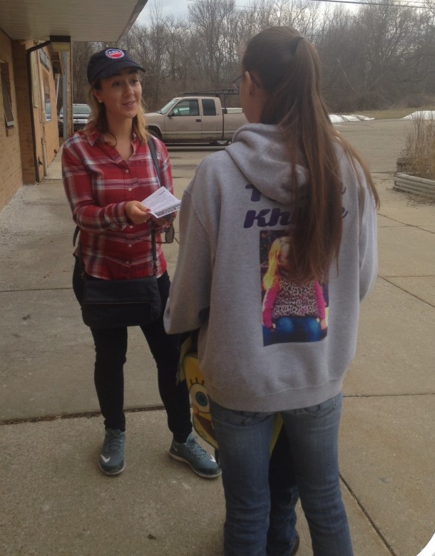
Community Involvement
Schedule Sampling
Providing Resources for the Community
Accompany Sample Teams
Answers Local Hotline
Speaking at Community Meetings
Canvassing Neighborhoods to Distribute Information
Region 5

Slide 18
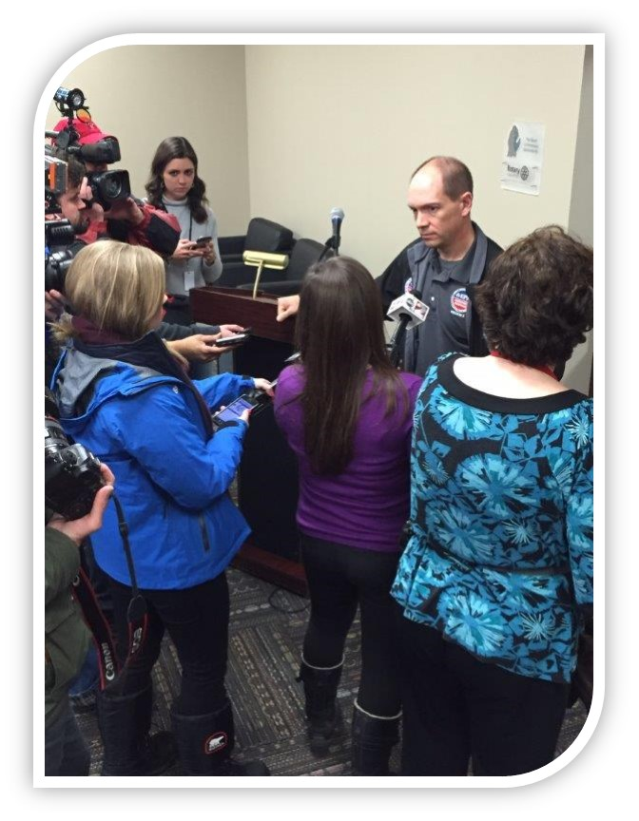

Public Affairs
Fact Sheets
Door Hangers
Media Interviews
Press Conferences
FAQs
Press Releases
Region 5

Slide 19
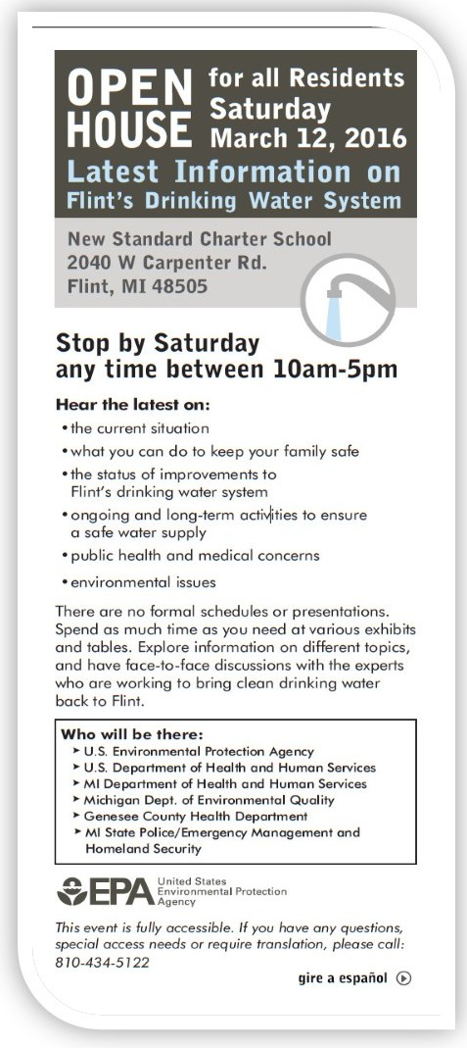
Open House 3/12
Data Summit 4/4
Open House 4/16
Region 5

Slide 20
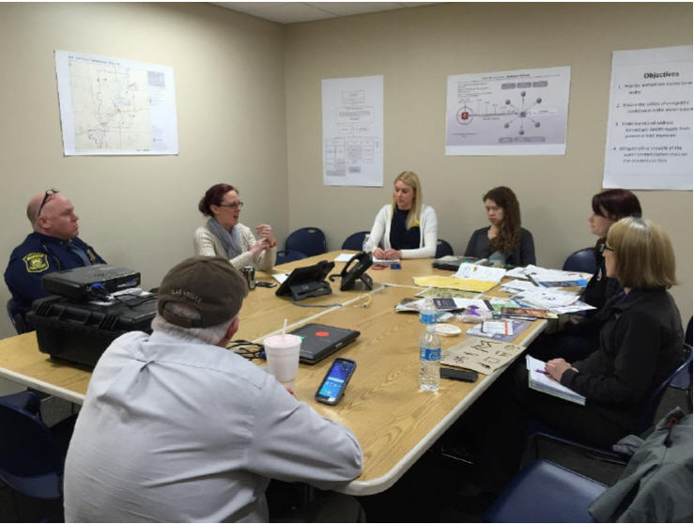
Flint Drinking Water Response
Unified Coordination Group

Slide 21
UCG Organization
Lead Federal Official
Dr. Nicole Lurie, HHS
FHCO
Tony Voirin, HHS
UCG
EPA, CDC, FEMA, State of Michigan
Operations
Planning
Logistics
Finance & Admin
Notes:
The U.S. Department of Health and Human Services (HHS) has been designated the lead federal agency responsible for coordinating federal government response and recovery efforts.
HHS, in collaboration with the Federal Emergency Management Agency (FEMA), identified and mobilized the capabilities of the rest of the federal partners – including the Small Business Administration, the Environmental Protection Agency (EPA), and the Departments of Housing and Urban Development (HUD), Education and Agriculture (USDA) -- that are already working to help residents in Flint.
The goal of the larger federal response is to help state and local leaders identify the size and scope of the problem, and work with them to make and execute a plan for mitigation of the short- and long-term health effects of lead exposure.
The federal team is be led by Dr. Nicole Lurie, HHS Assistant Secretary for Preparedness and Response (ASPR).
The agency has already been actively engaged in response and recovery efforts, including:
Providing, at the State of Michigan’s request, a range of technical assistance to state and local health departments, public health practices for medical professionals, and public health communications;
Working with HHS grantees in the area to disseminate public health education through Head Start and Community Health Centers programs, administered by HHS’s Administration for Children and Families and Health Resources and Services Administration, respectively;
Providing technical assistance related to case management processes and interventions for children with high blood lead levels and interpretation of blood lead levels in adults; and
Using existing resources to help the state identify vulnerable populations in Flint who may need further targeted outreach.
FEMA, EPA, HUD, and USDA are also actively engaged in existing response and recovery efforts.
FEMA is providing bottled water and filters to Flint.
EPA is working with state and local officials to reduce lead levels in tap water and provide safe drinking water to the residents of Flint. EPA is also conducting a comprehensive audit of the Michigan drinking water program and a detailed review Michigan’s implementation of the Safe Drinking Water Act in Flint. In October 2015, EPA established a task force to provide recommendations to the State of Michigan and the City of Flint to re-optimize corrosion control as soon as possible and to prepare for the planned switch to water supplied by the Karegnondi Water Authority in 2016
HUD is working closely with the city on economic development and interagency coordination. They have successfully assisted the city with the purchase and installation of water filters. HUD had an existing lead hazard grant to Flint, targeted to lead paint, $325,000 of which could be used for addressing the water lead contamination. Additionally, HUD has provided a data tracking and reporting system for the State of Michigan to use in its lead investigations.
USDA has waived requirements on potable tap water availability at school meal service, allowing schools to provide bottled water. The Special Supplemental Nutrition Program for Women, Infants, and Children (WIC) is also allowing participants to use WIC vouchers for ready-to-feed infant formula, which does not need to be mixed with water, and participants can also swap powdered formula for ready-to-feed formula.

Slide 22
Operations
Operations
Water Quality Task Force
EPA, ATSDR
Human Services
Task Force
HHS
Nutrition & Education Task Force
USDA
Health & Medical
Task Force
HHS, CDC
Public & External Affairs
Task Force
HHS, EPA, FDA, FEMA, CDC
Notes:
Human Services TF (disbanded)
In conjunction with the Genesee County Health Department, has set up an on-site lead blood testing
Working with HUD
Health & Medical TF
Support Genesee County Health Department to develop a comprehensive lead screening process. Identify appropriate lead educational materials and develop processes to support community messaging by Genesee County Health Department.
Provide nurse case work management to Genesee County Health Department.
Optimize the capacity of Genesee County Health Department staff to successfully respond to telephone calls related to lead.
Identify optimal mechanisms to track and share lead-related data with MDHHS and Genesee County Health Department stakeholders.
Nutrition & Education TF
Assess progress towards enhancing healthy food availability for the community.
Public & External Affairs TF
Coordinate the development of targeted public health messaging and communication products for lead exposure in collaboration with the Genesee County Health Department, the Michigan Department of Health and Human Services, US Environmental Protection Agency and other partners.
Coordinate the intergovernmental, public and external affairs effort to ensure awareness and visibility of communications activities regarding Flint water crisis.
Ensure a coordinated approach to public messaging and outreach with state partners. (PEATF)

Slide 23
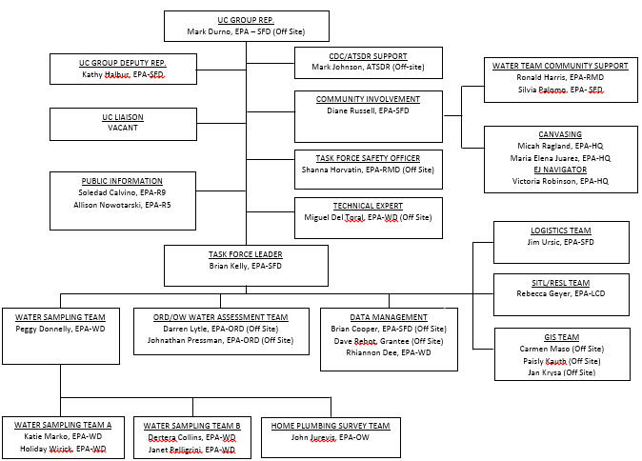
Water Quality Task Force

Slide 24
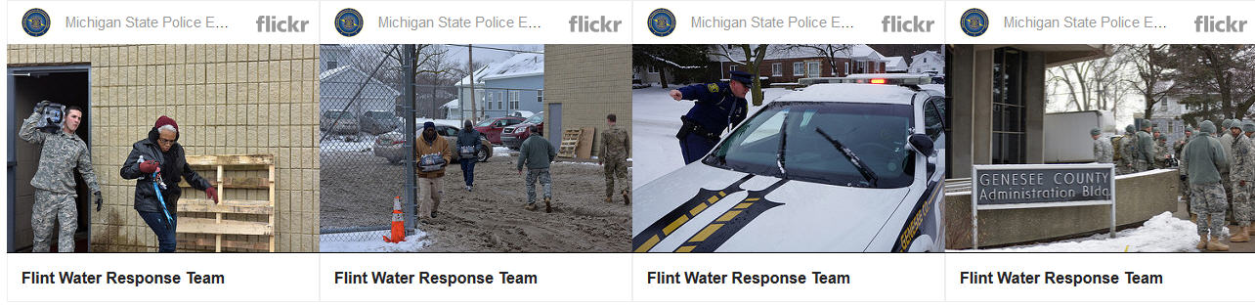
State Mission
Sentinel Sites
School Sampling / Fixtures Replacement
Sampling of Day Cares and Other Child Locations
Sampling of Businesses / Food Establishments
Oversight of Drinking Water Plant
Oversight of Distribution System

Slide 25
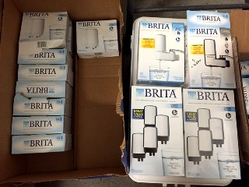
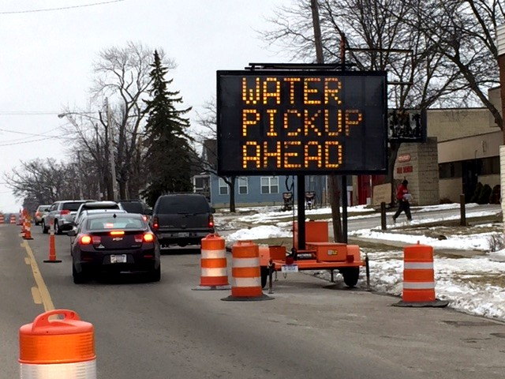
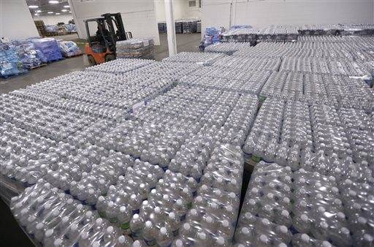
Commodity Mission

Slide 26
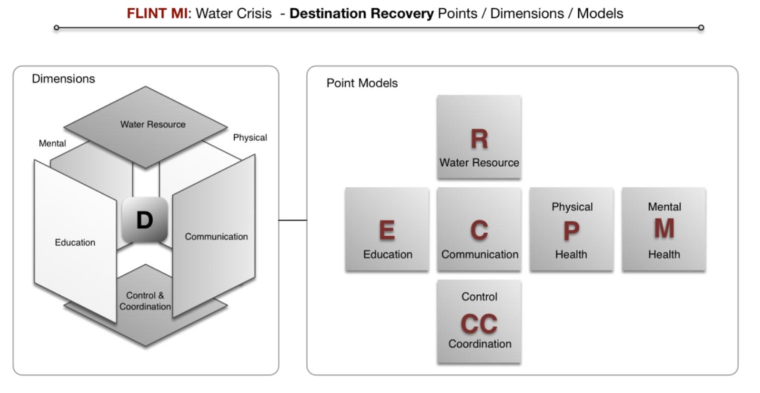
Recovery Plan
Notes:
Red Cross – Coordinating recovery plan because of lack of resources at city and county levels.
The purpose of this overarching recovery plan is to provide a common planning model including the community objectives, activities, and success criteria to enable the affected community to recover from the water crisis. This plan will be supplemented by plans produced by each partner agency based on the objectives and activities agreed upon by each partner organization. This plan is also intended to provide a common view among all participating organizations into the objectives, activities, responsibilities, and resources required to reach destination recovery.

Slide 27
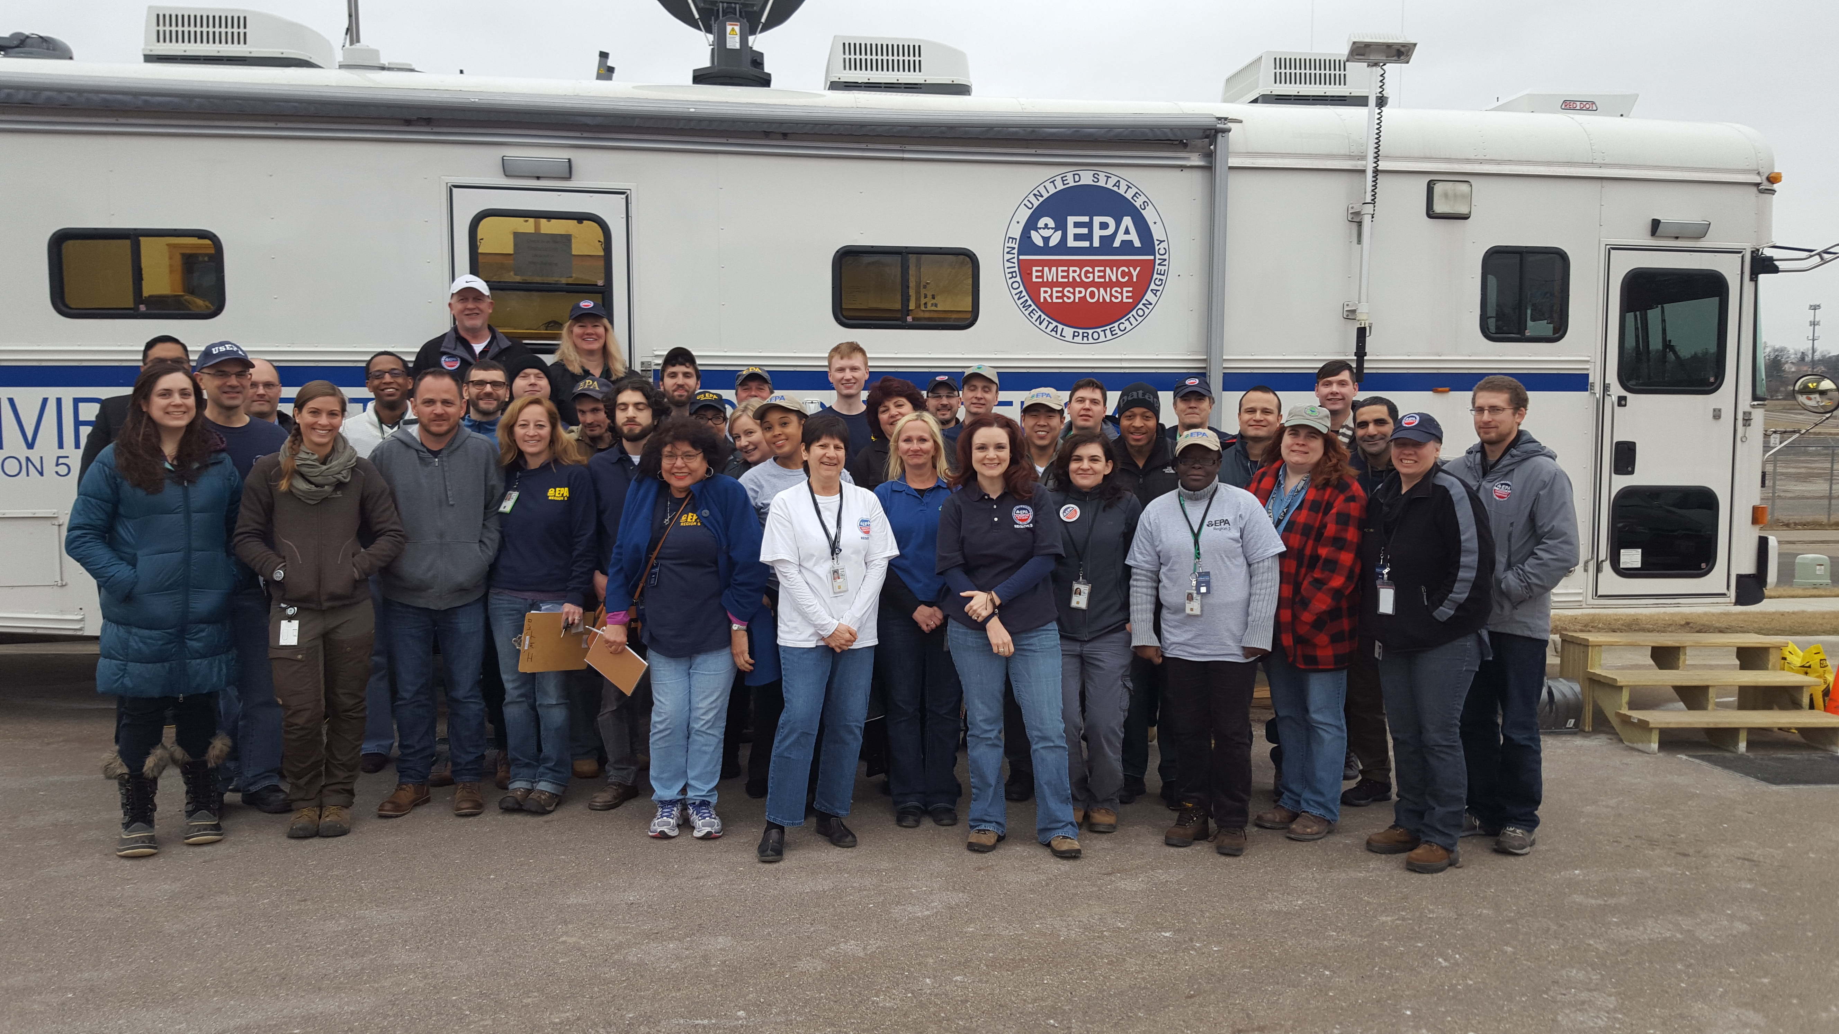
Q&A
Notes:
Red Cross – Coordinating recovery plan because of lack of resources at city and county levels.
The purpose of this overarching recovery plan is to provide a common planning model including the community objectives, activities, and success criteria to enable the affected community to recover from the water crisis. This plan will be supplemented by plans produced by each partner agency based on the objectives and activities agreed upon by each partner organization. This plan is also intended to provide a common view among all participating organizations into the objectives, activities, responsibilities, and resources required to reach destination recovery.

